Slide 1
Arts and Humanities Research Council (AHRC) Cross-Research council Programme on Connected Communities
A review of conceptualisations and meanings of ‘community’ within and across research traditions: a meta-narrative approach

Slide 2
summary
Objective of the research
Methodology
Explaining 10 meta-narratives
Implications for further research

Slide 3
Main objective of the research
Main research question is:
How have conceptualisations of ‘community’ changed over time within and across research traditions?
Sub-research questions:
What is known about discourses on communities within and across research disciplines?
How have these changed over time?
What are the implications for academic and policy development on the ground?
Time period: Between April and October 2011

Slide 4
Diagram methodology
Consultation events
(policy, academic)
Database
Sources known to the research team
Search
Mapping study for relevance
sociology
Mapping & screening
Identification of focus disciplines
anthropology
Identification of seminal studies
Within disciplines
political theory
MNR sociology
MNR
anthropology
MNR political theory
Across disciplines
Cross discipline meta-narrative synthesis
N=10 (meta-narratives)
Notes:
Farah put together a very clear methodology diagram
Various search methods: information specialist, snowballing and the important expert contribution of academic and policy advisory groups which have helped with identifying new areas of conceptualisation of research
Iterative: continue interaction between searching, mapping and screening
Transparent: we tried to make it as transparent as possible.
What are meta-narratives? Essentially they are storylines but technically they are “a shared set of concepts, theories and preferred methods used by a group of scholars at a particular time” (Greenhalgh, 2009).
So we tried to identify seminal authors and then build meta-narratives around their contribution by looking at backward and forward citation tracking
Firstly we developed meta-narratives in each research discipline (mainly sociology, anthropology and political sciences) and then we put them together so we created 9 meta-narratives across research disciplines.
8. We attempted to balance depth of research with breadth also given the time and resources for this work.

Slide 5
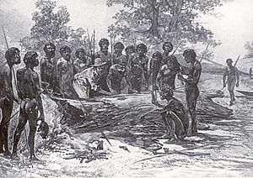
Meta-narrative one: commonality (anthropology)
Community is a natural phenomenon, it concentrates on the study of indigenous communities – distant ‘others’ in villages, tribes, partly rooted in colonialism
Community is
Geographically defined groups of people
Culturally and social homogenous
the location of research rather than the object of research (Rapport & Overing, 2000).
Important as starting point from where anthropological work developed

Slide 6
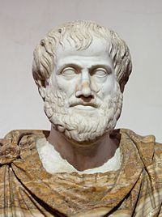
Meta-narrative two: The public sphere and formation of community
This meta-narrative draws upon political
theory and marks the beginning of
community in a political sense.
Aristotle focuses on values and principles
that characterise how people associate
rather than emphasising who constitutes
the State
This leads later scholars to consider forms of associations beyond the state.

Slide 7
Meta-narrative three: Transitionary perspectives on community
- Start of community in sociology and anthropology (1880s)
Concern following industrial revolution (Tӧnnies, Durkheim and Marx)
E.g. Transition from community to society (Tӧnnies). Community is rural, moral stability, naturally developing, based on kinship and strong relationships, and inherently good; society is urban, individualistic, artificial, loose relationships based on convenience, and largely negative.
Major influences on community studies (Brint, 2001) and other meta-narratives

Slide 8
Meta-narrative four: Community in urban space
- Combines sociological and anthropological work originating in the School of Chicago (from 1920s)
- Urban space is the problem (e.g. Segregation, inequality) but also the solution (e.g. dynamism, innovation)
- Community is not homogenous, but diverse, dense and transient (Wirth, 1938). They find the community in urban areas (urban villages, e.g. Gans, 1962)
Emphasis on space (concentric areas with central business districts and the inner city, zones of transition)
Mainly studies dynamics of groups, less interested in the perceptions of individuals
Notes:
concerned with explaining urban alienation but also
Study by Gans (1962) urban villagers about the Italian community in Boston

Slide 9
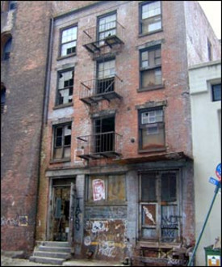
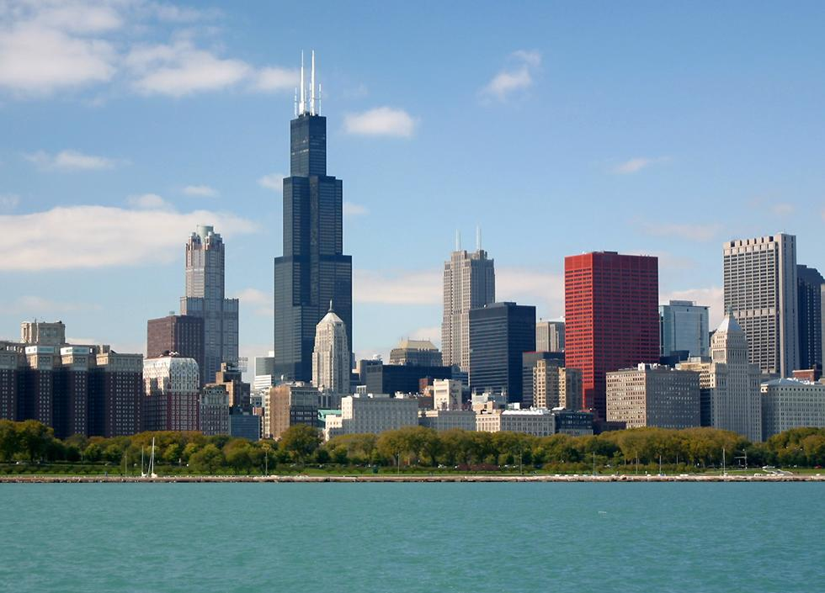

Slide 10
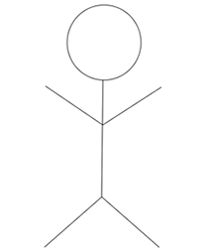
Meta-narrative five: Individualist versus communitarian approaches to community
- Community attracts interest from both sides of political spectrum
- Tension between liberalism (priority to the individual) esp. Rawls (1971) and communitarianism (priority to the group/community).
Various forms of communitarianism have emerged (e.g. Etzioni). Shared values, solidarity, attachments . Greater attention to cultural difference but at the cost of social equality (Delanty, 2003)
However, communities are increasingly virtual, fluid in membership, superdiverse, insecure, transient

Slide 11
Meta-narrative six: Community studies
Primary aim is to study all types of interactions that take place outside the household (Crow and Allan, 1994)
Critique to the School of Chicago which over-emphasised space
and dynamics of large groups
(from 1960s)
-It draws upon Tӧnnies in terms of
its emphasis on kinship (Brint, 2001)
but it has substantially developed
since (e.g. Network analysis)
-Concerned with building a
conceptualisation of community from empirical work driven by case study research and participant observation (Bell and Newby, 1971)

Slide 12
Meta-narrative seven: Generating or
mobilising community
Community is a social construction, it is an ‘ideal’ to be aspired to through collective action. it does not exist in ‘nature’ but needs to
be built (Marx)
Providing ‘voice’ to marginalised groups
around common concerns to contrast both
market and state
e.g. community development tradition

Slide 13
Meta-narrative eight: symbolic approaches to community (from 1980s)
Communities are symbolic constructs that emerges from a perception of boundary which separates one group from another (Cohen, 1985)
community is a ‘relational’ concept. It is
determined by defining who is in and who is
out.
Communities are a way for people to make
meanings of reality
Community are also imagined in the sense
That people do not need f2f interaction.
Communities are built around sentiments which are generated through people sharing and reading the same documents and thus generating a common understanding (Anderson, 1983)

Slide 14
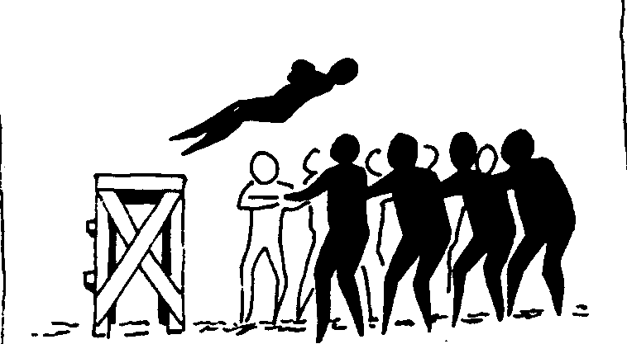
Meta-narrative nine: market economy perspectives on community
Trust relations, reciprocity which are assumed to flow from communities can create ‘social capital’ which positively influences both market economies and democracy (Fukuyama 1996; Putnam, 1993) (e.g. Bonding and bridging social capital)
Communities in this sense are
promoted as they bring a range of
advantages primarily economic and
of civic participation
This recognises that social relations
Influence economic and political
structures

Slide 15
Meta-narrative ten: Globally oriented approaches
- Globalisation, technological and transport changes, transience can be seen as a powerful critique of localities and community as place (e.g. virtual communities).
- Place is replaced with flows (Castells, 1996;
Urry, 2000). E.g. globalisation has both
negative and positive impact on
communities
- More choice to belong or not belong to a community (Fluidity of membership)
-Weak ties as opposed to strong ties (thin and thick) (Turner, 2001).
- More imagined communities (less f2f contact) but
Diluted messages?
Notes:
(e.g. It can link communities with wider movements for change).

Slide 16
Conclusions
emphasis changes over time (space, individual versus collective, connections, networks)
A marked shift in the 1980s with symbolism, imaginings, and sentiments. A much stronger focus on the individual (belonging, affect?).
further shift away from space, towards flows. Thin communities?
Implications for future research:
need to study how people negotiate their simultaneous belonging to several communities and how these influence each other.
Notes:
and we most probably forgotten some

Slide 17
Policy implications
Consultation sessions and review of literature highlighted a gap between the conceptualisations of community and policy practice
On the one hand, in policy (e.g. Big Society) what is meant by community is often space based and linked to traditional ideas of community
- On the other, many conceptualisations of community and some extremely difficult to apply into practice
However, there is a need to bridge this gap. Perhaps one way to do this, is to examine in detail empirical research on community examining the contribution of different meta-narratives and bring in other fields (e.g. Community psychology)

Slide 18
Policy implications cont
This work could be used to help decision-makers to think about what assumptions they are making about communities and expose them to alternative ways to understanding communities.

Slide 19
Thank you!

